Slide 1

Weather & Wireless Communication
How wireless communication enables needed real time pervasive climate data collection

Slide 2
Timeline / Overview
Session I: Weather and Wireless
weather/climate
projects/applications
group
Sensors
Group (DHT, anemometer, RTC)
Wireless communication
Data types, Serial, nRF24
Wireless tech
Show examples
Group
Design (draw circuit Input, processing, wireless, output)
Session II
Build
Session III
Wrap up, Test and Share out
10 min per group
Session IV
Further Exploration
Anemometer
Notes:
10 weather/climate
10 projects/applications
group
10 Sensors
Group (DHT, anemometer, RTC)
10 Wireless communication
Data types, Serial, nRF24
10 Wireless tech
Show examples
Group
Design (draw circuit Input, processing, wireless, output)

Slide 3
Weather vs. Climate
Weather:
Short-term atmospheric conditions in a specific place at a specific time.
Includes daily changes in temperature, humidity, precipitation, wind, and visibility.
Example: Today's forecast predicts rain, yesterday was sunny and warm.
Climate:
Long-term average of weather patterns over an extended period (usually 30 years or more) in a specific region.
Describes the typical conditions and variations experienced over seasons and years.
Example: The Mediterranean climate is characterized by hot, dry summers and mild, wet winters.

Slide 4
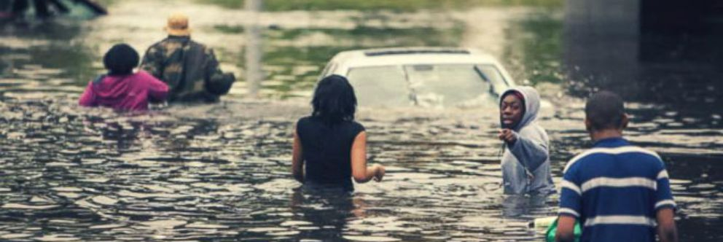
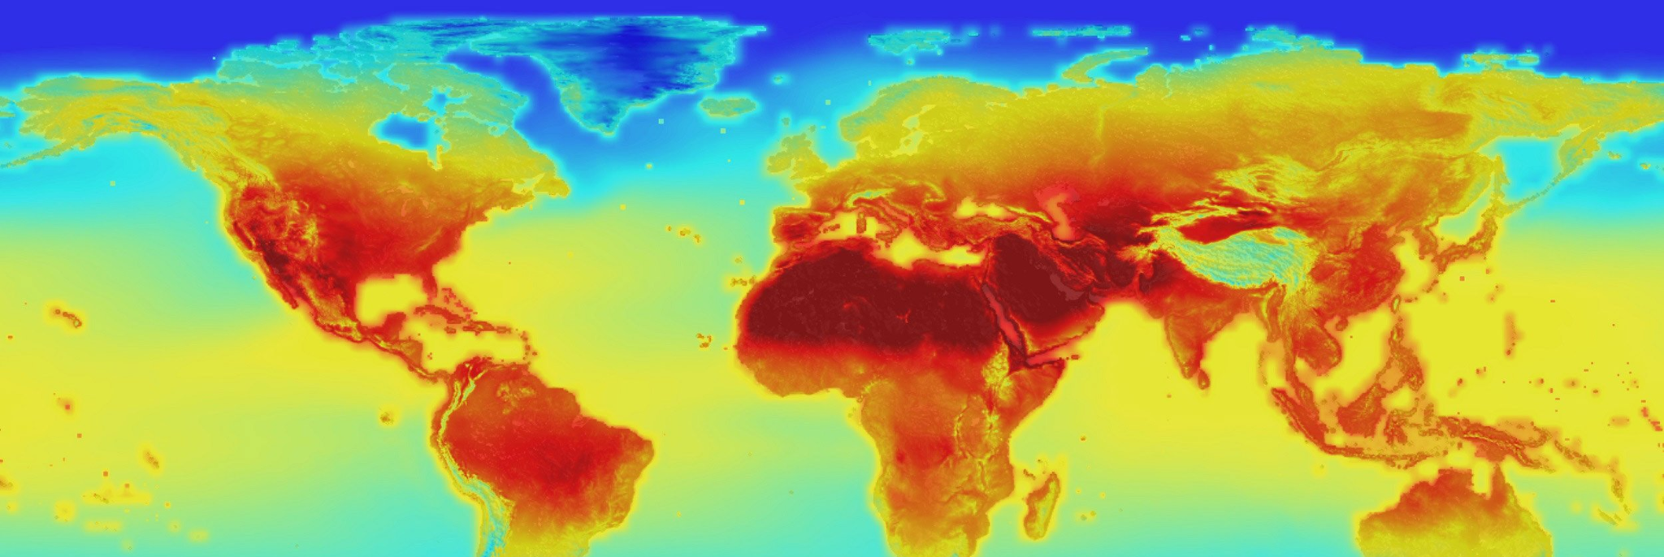
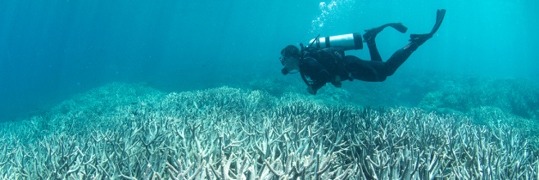
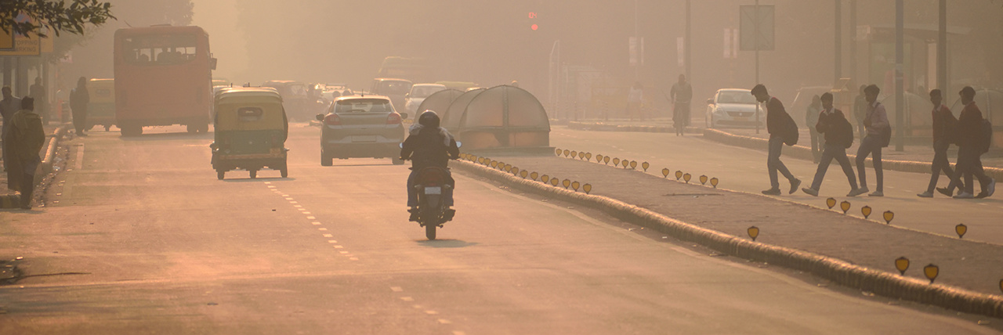
Importance of Weather Data
Daily Activities
Safety & Emergency Preparedness
Economic Impact
Climate Change Monitoring
Environmental Protection
Scientific Research
Public Health
Notes:
Collecting weather data is essential for several reasons. For daily activities, it helps people plan and adjust their schedules based on accurate forecasts. Safety and emergency preparedness rely on weather data to issue timely warnings and alerts, potentially saving lives during natural disasters.
From an economic perspective, industries like agriculture, transportation, and energy use weather data to optimize operations and reduce losses. Long-term climate data is crucial for monitoring climate change, providing insights for mitigation and adaptation strategies.
Environmental protection efforts benefit from weather data by monitoring conditions that affect natural resources and wildlife. Scientific research relies on this data to improve forecasting models and understand atmospheric phenomena. Finally, public health initiatives use weather data to monitor conditions like heatwaves and air quality, helping protect community health.

Slide 5
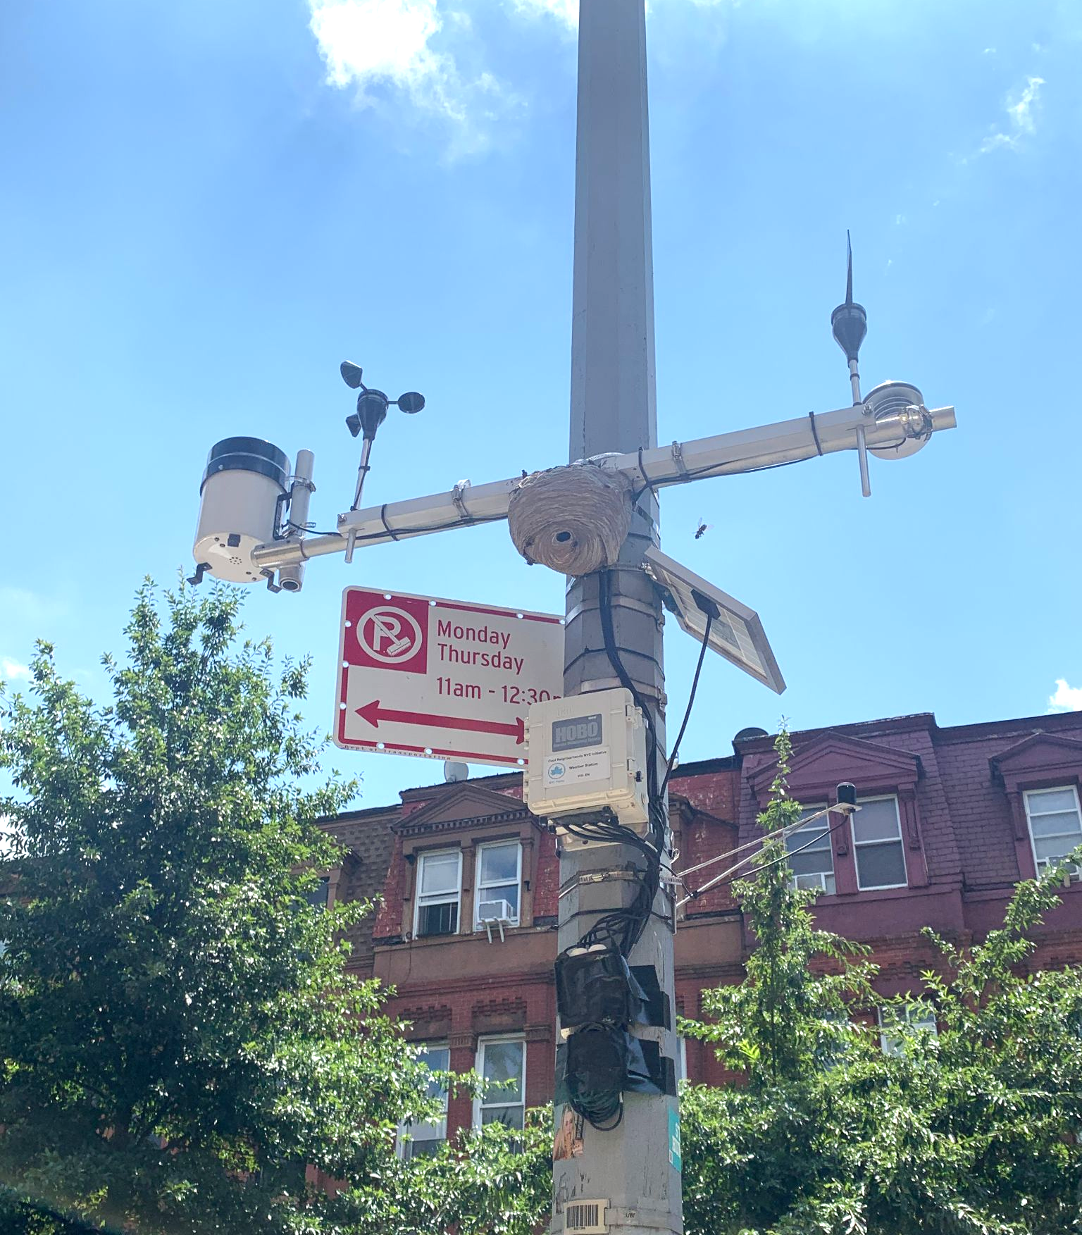
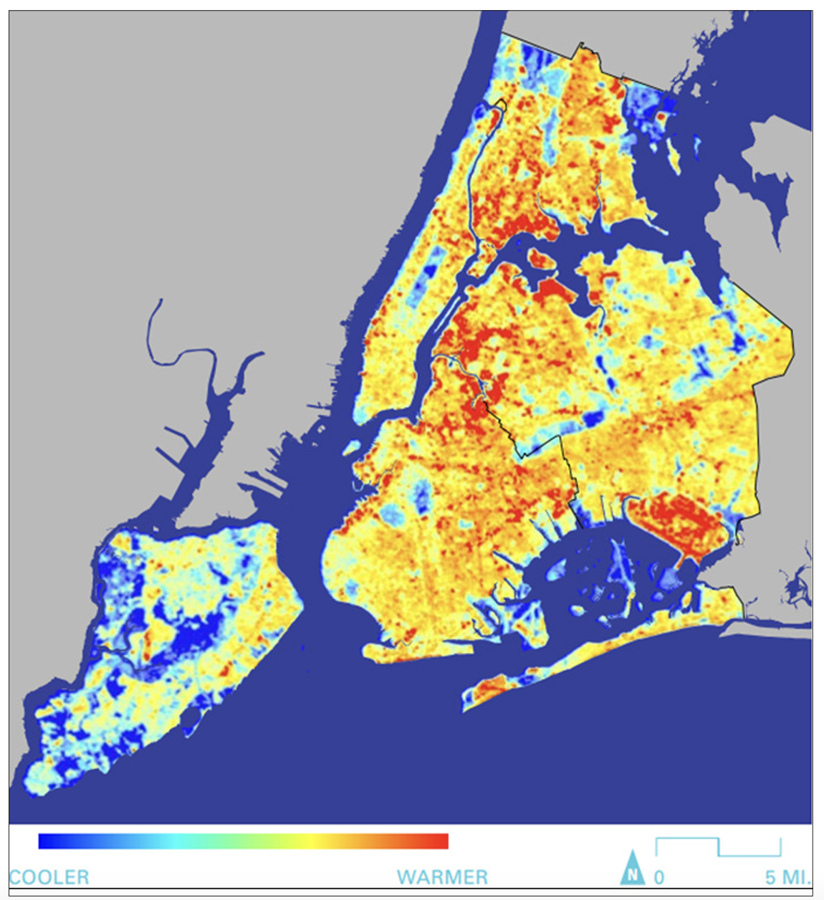
Geographic and Historical Climate Variance
Cool Neighborhoods NYC Initiative
https://climate.cityofnewyork.us/reports/cool-neighborhoods-nyc/
Notes:
The spatial variation within New York City’s densely built environment—including the distribution of its vegetation, varied building and other land cover typologies, and surface materials—results in differentiated heat risk at the local level. Studies have shown that certain landscape classes are key drivers of surface temperature in cities.54 When certain landscape classes are compared with geographic patterns of social risk, they often overlap with disadvantaged neighborhoods. As a result, the effects of extreme heat are disproportionately borne by many of the most vulnerable New Yorkers. Temperature monitoring is a crucial component of effectively targeting heat mitigation and adaptation strategies around the city. To better understand the geography of NYC’s microclimates and differentiated vulnerability, the City is investing $300,000 to collect baseline neighborhood-level temperature information. This will be used to assess current risk, more effectively target new initiatives in the most heat-vulnerable neighborhoods, and in the long-term, provide baseline data to accurately measure the impact of interventions. Over the next two years, this data collection and analysis will empower the City to inform and target future capital investments in natural infrastructure; to identify operational and policy strategies that address and adapt NYC to the increasing impacts of UHI effect and extreme heat. Finally, this work will allow us to identify the need for additional monitoring and research initiatives that can improve our knowledge of temperature variation and model the effectiveness of needed interventions.

Slide 6
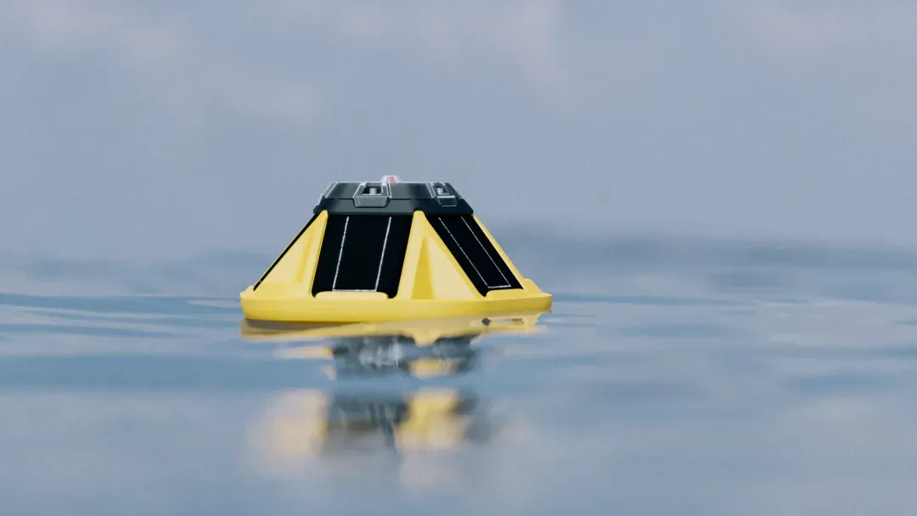
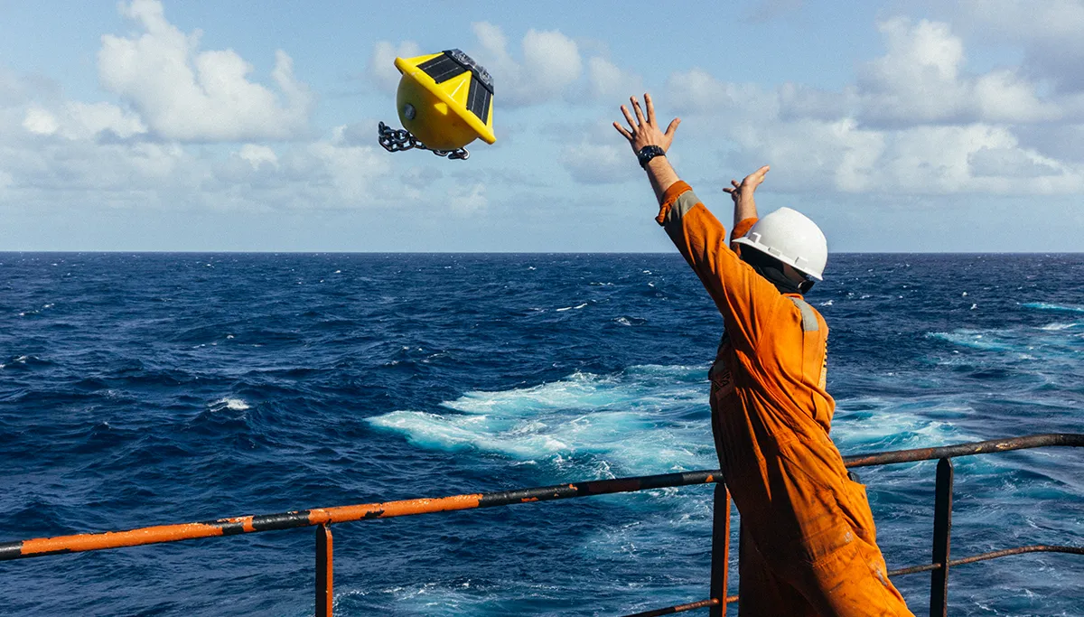

Oceanographic Data
hundreds of Spotters deployed globally free-drifting or moored
largest privately-owned network of ocean sensors.
Each day, makes more than 1.5 million real-time observations
Use the Spotter Dashboard and API to access real-time data sent via satellite and cellular and stored in the cloud
buoys make direct observations of wave spectra, wind, sea surface temperature, and atmospheric pressure.
https://www.sofarocean.com/
https://argo.ucsd.edu/data/
https://sio-argo.ucsd.edu/statusbig.gif
Notes:
Sofar developed a marine sensing platform called Spotter and deployed hundreds globally to create the largest privately-owned network of ocean sensors. Each day, this network makes more than 1.5 million real-time observations of waves and other ocean variables.

Slide 7
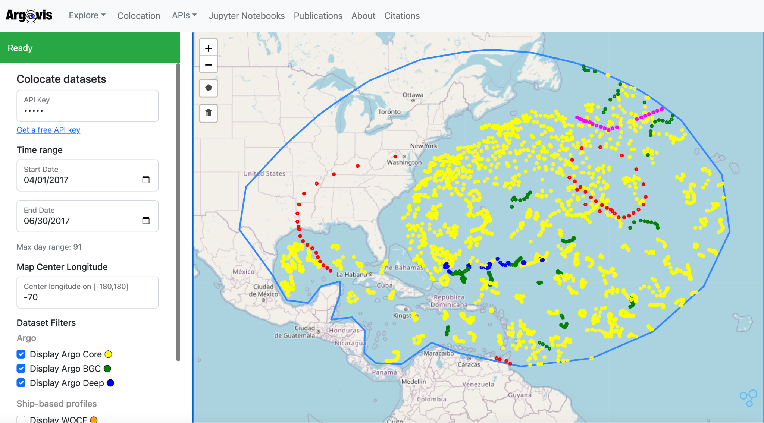
Oceanographic Data
https://argo.ucsd.edu/data/
https://sio-argo.ucsd.edu/statusbig.gif
https://argovis.colorado.edu/
Notes:
Sofar developed a marine sensing platform called Spotter and deployed hundreds globally to create the largest privately-owned network of ocean sensors. Each day, this network makes more than 1.5 million real-time observations of waves and other ocean variables.

Slide 8
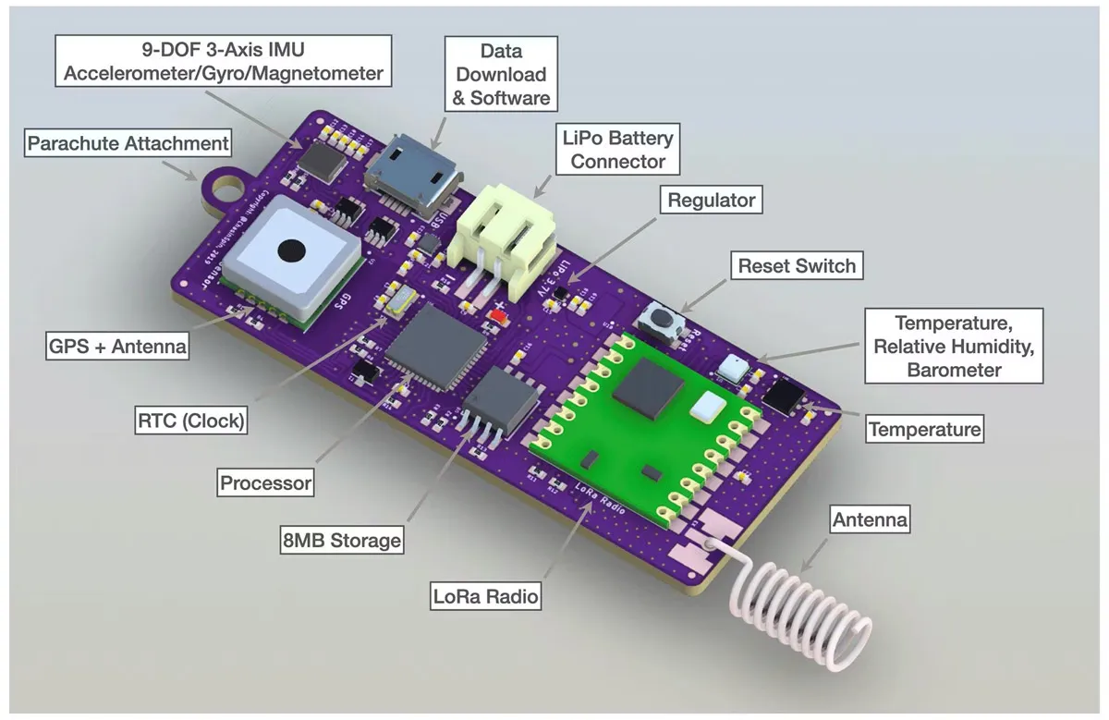
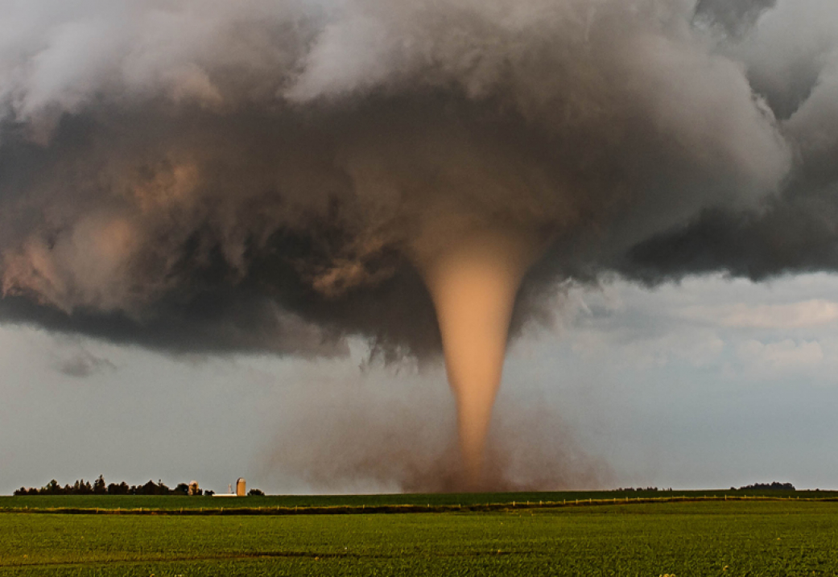
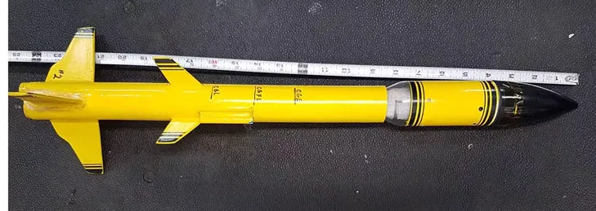
EXTREME WEATHER RESEARCH
Tornado Science Probe
https://makezine.com/article/science/storm-chasers-real-twister-tech/
Notes:
throughout the 19th and early 20th centuries, weather forecasting was primitive and so often wrong that tornado forecasts were actually banned by the US Weather Bureau for fear they would cause unnecessary panic. This blind eye to the dangers cost many lives. 1925’s massive Tri-State Tornado killed 751 people in Missouri, Arkansas, and Tennessee. The Tupelo-Gainesville Tornado Outbreak of 1936 ended 454 lives across the South.
It wasn’t until a tornado hit Tinker Air Force Base on March 25, 1948, that accurate prediction became a mission for the US government. The Oklahoma air base was ravaged by a twister five days prior on March 20, wrecking aircraft and buildings. Air Force meteorologists Major Ernest J. Fawbush and Captain Robert C. Miller were tasked to predict when the next would hit. When they noticed similar conditions only 5 days later, they indeed made the first successful prediction of a tornado, and science became the focus. The early 1950s saw the advent of radar systems to monitor storm conditions, and a formal warning system followed soon after.
Dr. Reed Timmer, owner of the Dominator 3 talked about how he and his team created a probe that was launched from the Dominator 3, circled around the tornado a few times, and shot off into the upper atmosphere — 30,000 feet or so. The rocket probe, dubbed Project Skyfall, not only recorded the data but also streamed it. It was trackable and recovered in the field. It survived, too. The results were never seen in the weather community before.

Slide 9
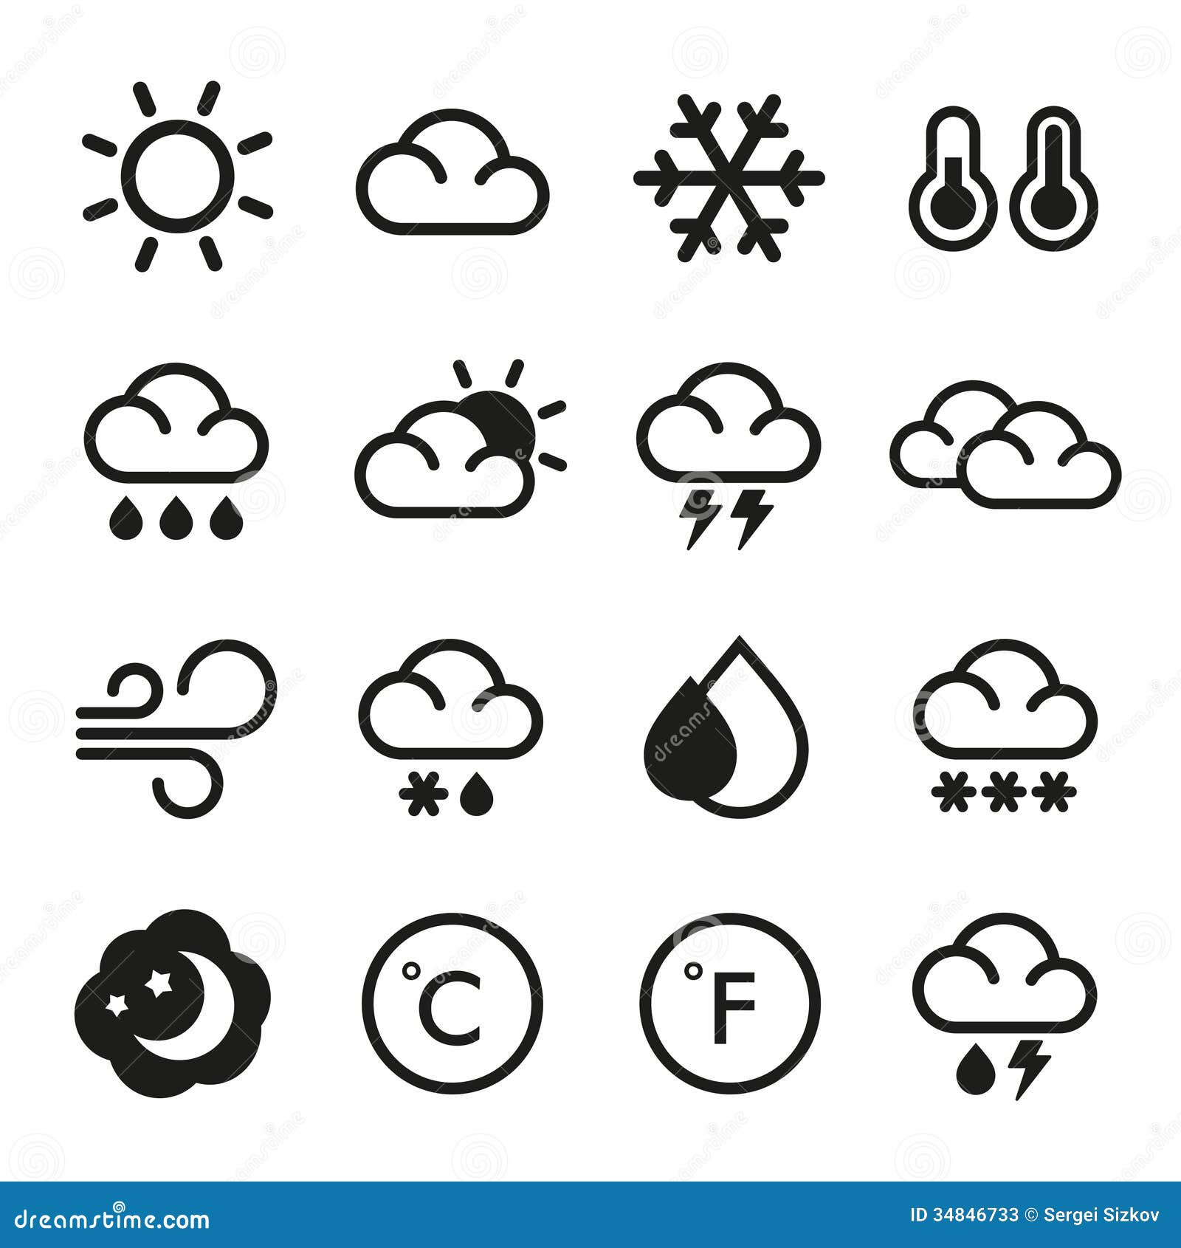
Types of Weather Data
Temperature
Humidity
Precipitation
Wind Speed and Direction
Atmospheric Pressure
Solar Radiation
Visibility
Cloud Cover
Air Quality

Slide 10
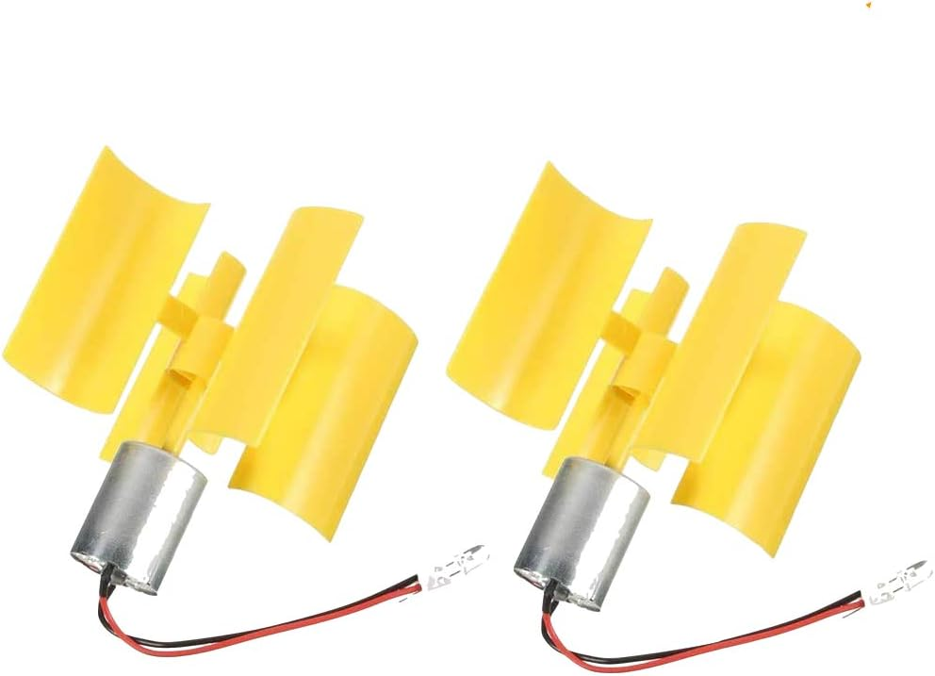
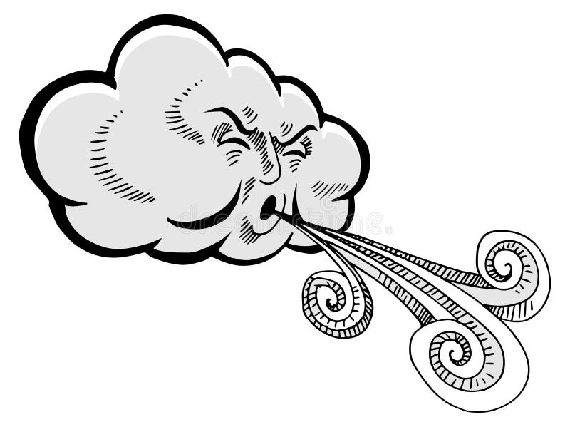
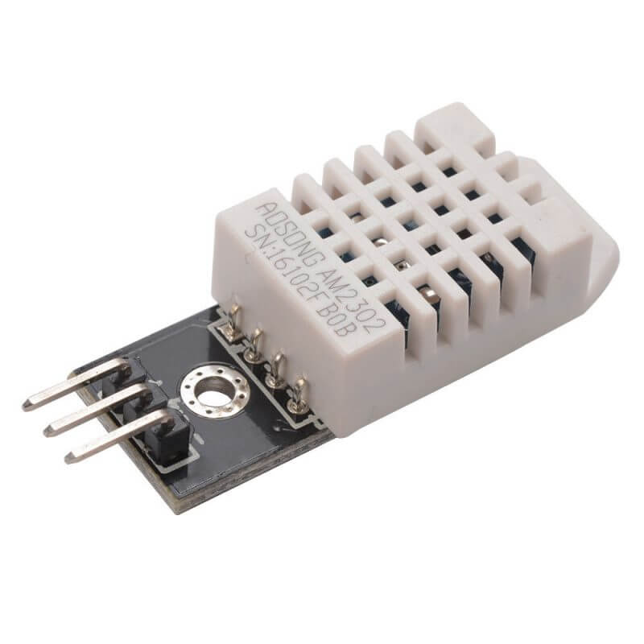
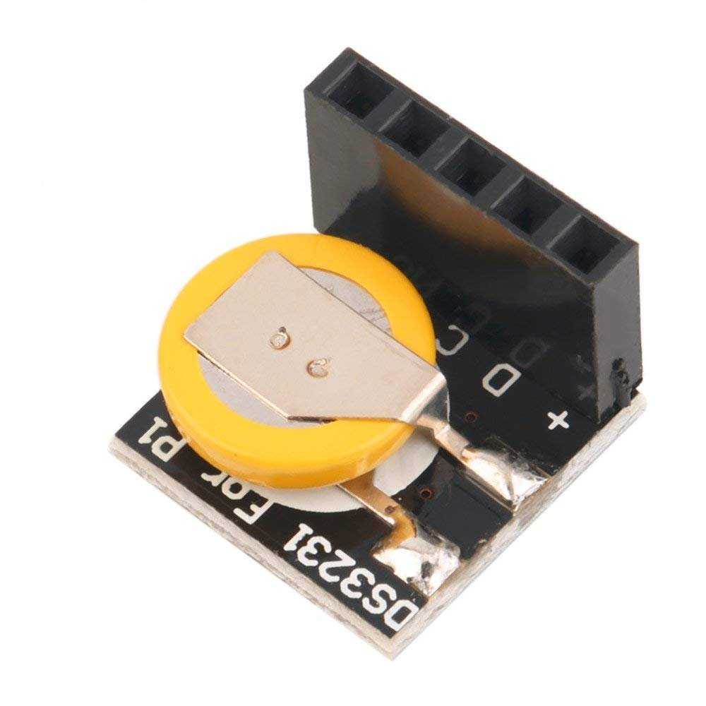
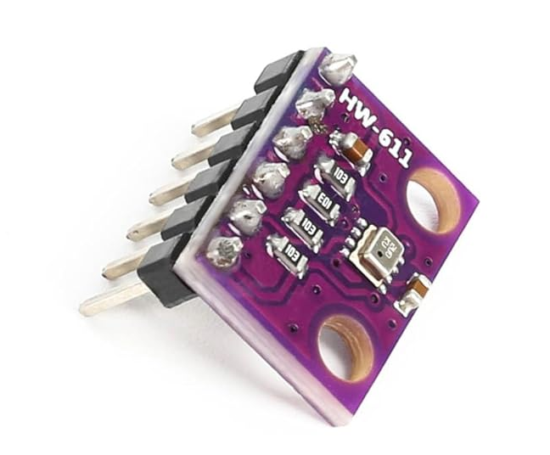
Sensors
DHT-22
Humidity
Temperature
Anemometer
Wind Speed
RTC
Time
BMP280

Slide 11

Wireless Data Flow
INPUT
PROCESS
OUTPUT
Storage
Database (MySQL
Cloud
Display
LCD (16x2)
Mobile App (Blynk)
16x16 LED Matrix
Web page (Adafruit IO)
Sensors
DHT-11
BMP280
BMP680
Anemometer
Microprocessors
Uno
ESP32
XIAO
Wireless tech
Bluetooth
WiFi
nRF24
GSM

Slide 12
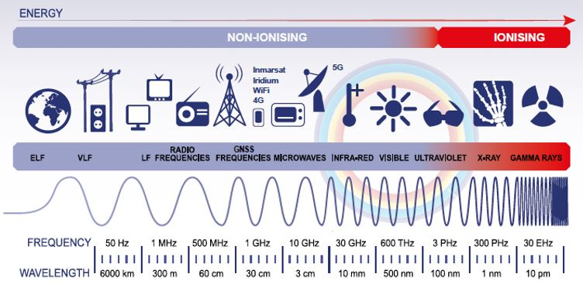
The Electromagnetic Spectrum

Slide 13
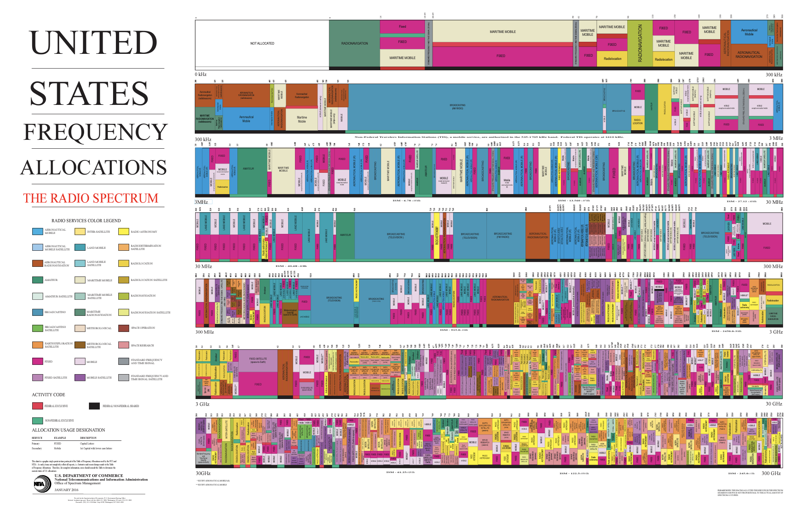
Wireless = Radio
https://www.ntia.gov/sites/default/files/publications/january_2016_spectrum_wall_chart_0.pdf

Slide 14
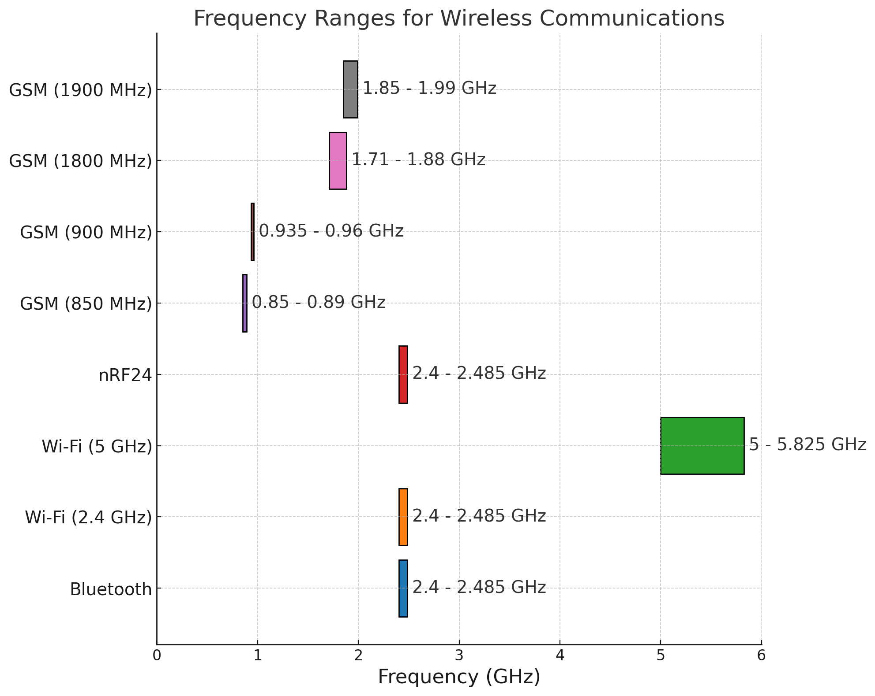
Frequency Ranges
Why Ranges Exist:
Interference Management
Regulatory Compliance
Technology Needs
Broad Ranges
Higher Data Rates
Reduced Interference urban areas
Shorter Range (obstacle penetration)
Narrow Ranges
Simplicity: Easier design, lower power use.
Cost-Effective devices
Compatibility
Notes:
Ranges and Variations
Why Ranges Exist:
Interference Management: To avoid signal overlap and disruptions.
Regulatory Compliance: Governed by rules to organize spectrum use.
Technology Needs: Different bandwidths and data rates require specific ranges.
Broad Ranges (e.g., 5 GHz Wi-Fi)
Higher Data Rates: Supports wide channels for fast data transfer.
Reduced Interference: Less crowded, better for urban areas.
Shorter Range: Limited by higher frequencies not penetrating obstacles well.
Narrow Ranges (e.g., Bluetooth, nRF24)
Simplicity: Easier design, lower power use.
Cost-Effective: Ideal for small, low-cost devices.
Compatibility: Ensures interoperability across devices.
Benefits and Challenges
Broad Ranges:
Benefits: Higher speeds, less interference.
Challenges: Shorter range, obstacle sensitivity.
Narrow Ranges:
Benefits: Low power, cost-efficient.
Challenges: Limited data rates, more crowded bands.

Slide 15
Protocol and Handshakes
A case study of communication between devices
Goal: transmit temperature and humidity data from a DHT sensor connected to an Arduino UNO to an ESP32 using the nRF24 wireless communication module.
What Happened: communication did not work as expected. Despite having the correct wiring and power setup, the devices were not understanding one another, leading to blank serial outputs on the receiver side.
Root Cause: The differences in how the two processors handle data structures, memory alignment, and byte order causing the transmitted data to be misinterpreted by the receiver
Solution: a consistent data protocol by:
Serializing the data into a byte array before transmission.
Using memcpy to ensure data integrity.
Adding detailed serial debugging statements to trace the flow and identify issues.
Notes:
Slide Title: Protocol and Handshakes: Accommodating and Troubleshooting Communication Between Devices
Narrative:
In this presentation, I will walk you through a practical example of troubleshooting and ensuring reliable communication between different devices, specifically an Arduino UNO and an ESP32 using the nRF24 wireless module. This case study highlights the importance of understanding and respecting data structures, protocols, and handshakes between different technologies.
What We Tried to Do:
We aimed to transmit temperature and humidity data from a DHT sensor connected to an Arduino UNO to an ESP32 using the nRF24 wireless communication module. The goal was to have the ESP32 receive the data and display it on the serial monitor.
What Happened: Initially, the communication did not work as expected. Despite having the correct wiring and power setup, the devices were not understanding one another, leading to blank serial outputs on the receiver side.
Root Cause: The core issue was differences in how the two processors (Arduino UNO's AVR and ESP32's Xtensa) handle data structures, memory alignment, and byte order. This mismatch caused the transmitted data to be misinterpreted by the receiver, resulting in communication failure.
Solution:
We ensured that both devices adhered to a consistent data protocol by:
Serializing the data into a byte array before transmission.
Using memcpy to ensure data integrity.
Adding detailed serial debugging statements to trace the flow and identify issues.
Advice on Troubleshooting:
Wire Color Coding: Use consistent color coding for each pin/data line. For example, red for power (+), black for ground (–), and specific colors for data lines.
Testing One Technology at a Time: When integrating multiple technologies, test each component individually first. Ensure that each part works in isolation before combining them.
Wire Connections and Code:With nRF24 modules, meticulous troubleshooting of wire connections and code is crucial. Verify power connections, data lines, and ensure that the modules are properly initialized and set to the correct modes (TX/RX).
Data Differences Between Processors and Wireless Technologies:
Technology and Processor: Different processors (AVR vs. Xtensa) handle data types, memory alignment, and byte order differently. This necessitates careful handling of data structures to ensure compatibility.
Serial Communication: Use clear and consistent protocols for serial communication. Be mindful of baud rates and ensure both devices are configured correctly.
Arrays and Memory Allocation: Ensure that arrays are correctly allocated and memory is managed properly to avoid overflow or misinterpretation of data.
Data Types: Be aware of how different data types (int, float, double) are represented in memory. Use serialization techniques to convert data into a consistent format for transmission.

Slide 16
Designing a Weather Station
Understand:
Review materials and their functions.
Identify sensors, microcontroller, power source, and communication module.
Plan:
Sketch a layout.
Decide on sensor placement for accuracy.
Ensure stability and weatherproofing.
Assemble:
Connect sensors to the microcontroller.
Secure components on a stable base.
Test connections.
Program the Microcontroller:
Write code for sensor data reading.
Enable wireless data transmission (if applicable).
Test and debug the code.
Test and Calibrate:
Test in a controlled environment.
Calibrate sensors with known values.
Adjust for accuracy.
How will you ensure your weather station is weatherproof and stable?
What is the optimal placement for each sensor, and why?
How will you power your weather station (e.g., battery, solar power)?
How will you ensure accurate data transmission from your weather station to your data collection system?
What methods will you use to calibrate your sensors for accurate readings?
How will you protect your weather station from potential hazards like wildlife or vandalism?
What will be your process for regularly maintaining and updating your weather station?
What data do you need/want to collect?
What components do you need?
Github, Datasheets, oh my

Slide 17
Prompts
What type of radio does this technology use?
What are the power requirements for this technology?
What is the typical communication range of this technology?
How does this technology handle data transmission and reception?
What are the advantages and disadvantages of using this technology in a weather station project?

Slide 18
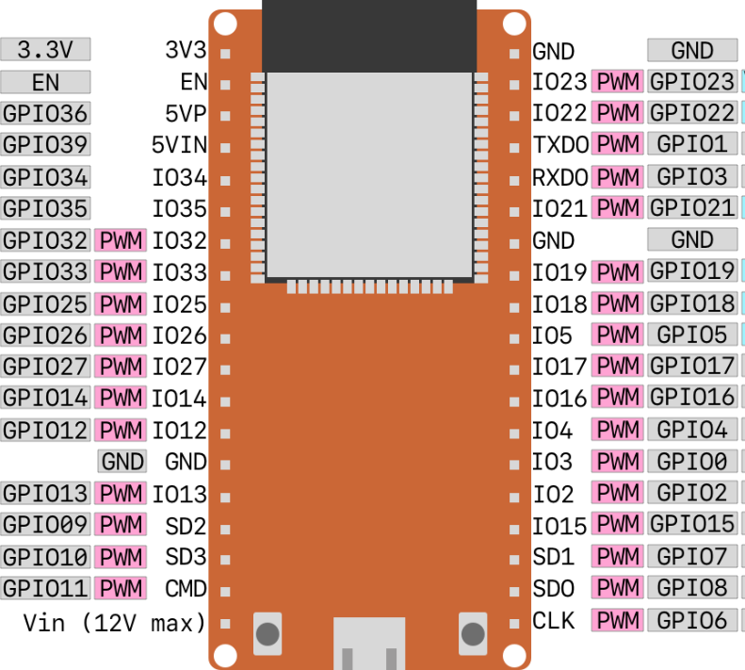
WiFi (ESP32)
prompts

Slide 19
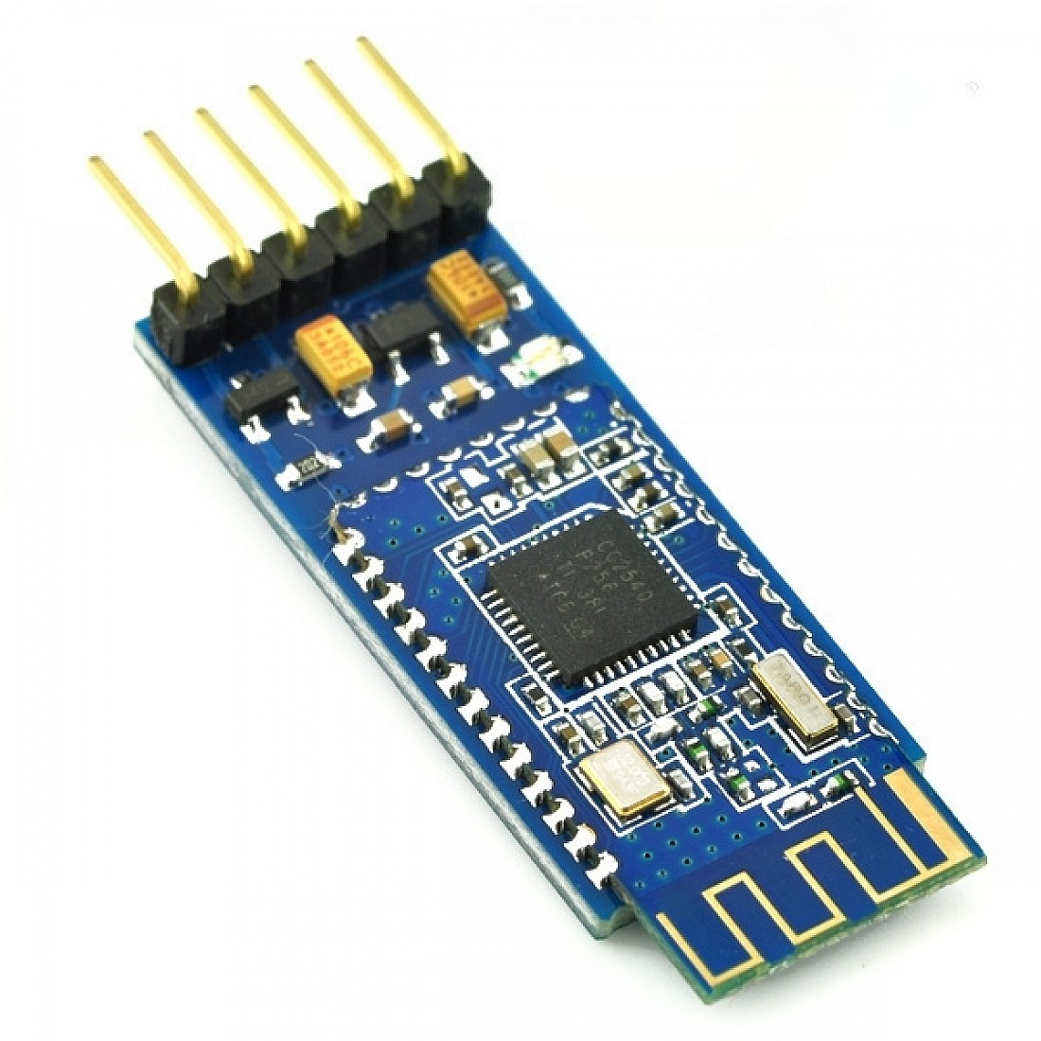
Bluetooth (HM-10)

Slide 20
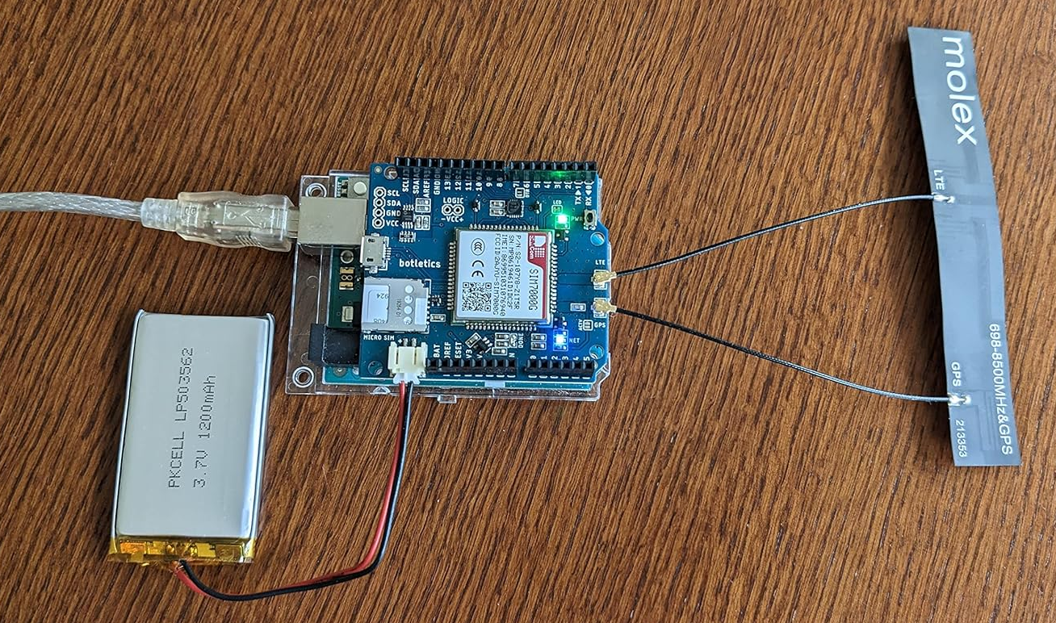
GSM (SIM7000)

Slide 21
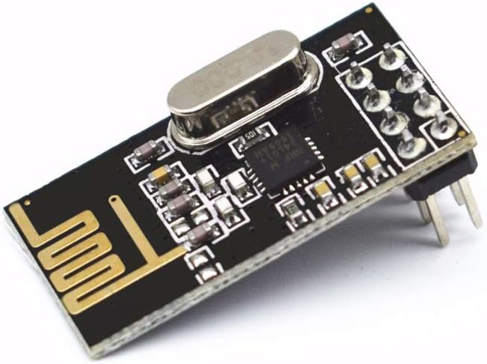
Transceiver (nRF24)

Slide 22
Session II: Build

